Slide 1
Chapter 1 Introduction to Computers, Programs, and Java

Slide 2
Programs
Computer programs, known as software, are instructions to the computer.
You tell a computer what to do through programs. Without programs, a computer is an empty machine. Computers do not understand human languages, so you need to use computer languages to communicate with them.
Programs are written using programming languages.

Slide 3
Programming Languages
Machine Language Assembly Language High-Level Language
Machine language is a set of primitive instructions built into every computer. The instructions are in the form of binary code, so you have to enter binary codes for various instructions. Program with native machine language is a tedious process. Moreover the programs are highly difficult to read and modify. For example, to add two numbers, you might write an instruction in binary like this:
  1101101010011010

Slide 4
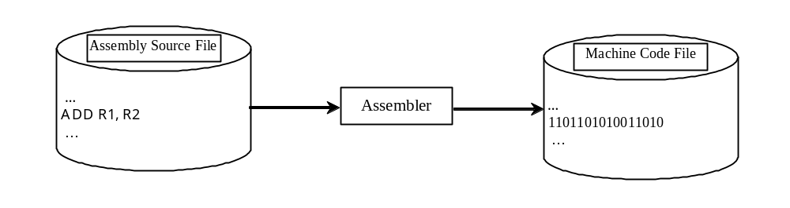
Programming Languages
Machine Language Assembly Language High-Level Language
Assembly languages were developed to make programming easy. Since the computer cannot understand assembly language, however, a program called assembler is used to convert assembly language programs into machine code. For example, to add two numbers, you might write an instruction in assembly code like this:
ADD R1, R2

Slide 5
Programming Languages
Machine Language Assembly Language High-Level Language
The high-level languages are English-like and easy to learn and program. For example, the following is a high-level language statement that computes the area of a circle with radius 5:
area = 5 * 5 * 3.1415;

Slide 6
Popular High-Level Languages
COBOL (COmmon Business Oriented Language)
FORTRAN (FORmula TRANslation)
BASIC (Beginner All-purpose Symbolic Instructional Code)
Pascal (named for Blaise Pascal)
Ada (named for Ada Lovelace)
C (whose developer designed B first)
Visual Basic (Basic-like visual language developed by Microsoft)
Delphi (Pascal-like visual language developed by Borland)
C++ (an object-oriented language, based on C)
C# (a Java-like language developed by Microsoft)
Java (We use it in the book)

Slide 7
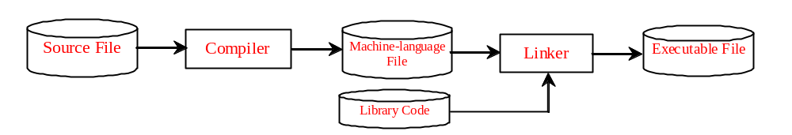
Compiling Source Code
A program written in a high-level language is called a source program. Since a computer cannot understand a source program. Program called a compiler is used to translate the source program into a machine language program called an object program. The object program is often then linked with other supporting library code before the object can be executed on the machine.

Slide 8
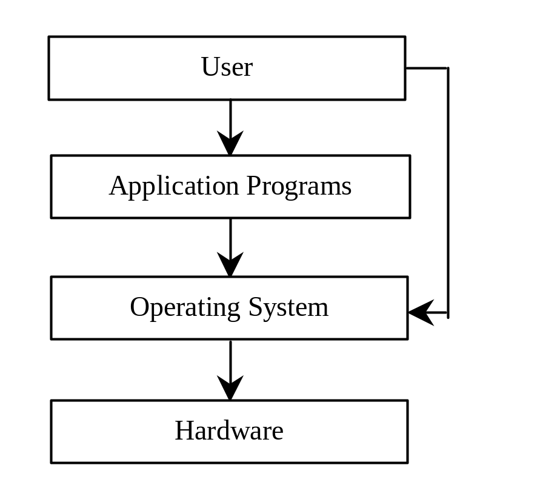
Operating Systems
The operating system (OS) is a program that manages and controls a computer’s activities. You are probably using Windows 98, NT, 2000, XP, or ME. Windows is currently the most popular PC operating system. Application programs such as an Internet browser and a word processor cannot run without an operating system.

Slide 9
Why Java?
The answer is that Java enables users to develop and deploy applications on the Internet for servers, desktop computers, and small hand-held devices. The future of computing is being profoundly influenced by the Internet, and Java promises to remain a big part of that future. Java is the Internet programming language.
Java is a general purpose programming language.
Java is the Internet programming language.

Slide 10
Java’s History
James Gosling and Sun Microsystems
Java, May 20, 1995, Sun World

Slide 11
JDK Versions
JDK 1.02 (1995)
JDK 1.1 (1996)
JDK 1.2 (1998)
JDK 1.3 (2000)
JDK 1.4 (2002)
JDK 1.5 (2004) a. k. a. JDK 5 or Java 5
JDK 1.6 (2006) a. k. a. JDK 6 or Java 6
JDK 1.7 (2011) a. k. a. JDK 7 or Java 7
JDK 1.8 (2014) a. k. a. JDK 8 or Java 8

Slide 12
JDK Editions
Java Standard Edition (J2SE)
  J2SE can be used to develop client-side standalone applications or applets.
Java Enterprise Edition (J2EE)
  J2EE can be used to develop server-side applications such as Java servlets and Java ServerPages.
Java Micro Edition (J2ME).
  J2ME can be used to develop applications for mobile devices such as cell phones.
This book uses J2SE to introduce Java programming.

Slide 13
Popular Java IDEs
NetBeans Open Source by Oracle
Eclipse Open Source by IBM

Slide 14
A Simple Java Program
Listing 1.1
//This program prints Welcome to Java!
public class Welcome {
public static void main(String[] args) {
System.out.println("Welcome to Java!");
}
}

Slide 15
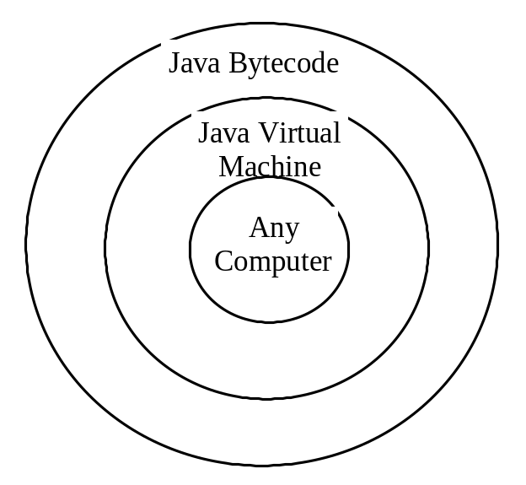
Compiling Java Source Code
You can port a source program to any machine with appropriate compilers. The source program must be recompiled, however, because the object program can only run on a specific machine. Nowadays computers are networked to work together. Java was designed to run object programs on any platform. With Java, you write the program once, and compile the source program into a special type of object code, known as bytecode. The bytecode can then run on any computer with a Java Virtual Machine, as shown below. Java Virtual Machine is a software that interprets Java bytecode.

Slide 16
Trace a Program Execution
animation
Enter main method
//This program prints Welcome to Java!
public class Welcome {
public static void main(String[] args) {
System.out.println("Welcome to Java!");
}
}

Slide 17
Trace a Program Execution
animation
Execute statement
//This program prints Welcome to Java!
public class Welcome {
public static void main(String[] args) {
System.out.println("Welcome to Java!");
}
}

Slide 18

Trace a Program Execution
animation
//This program prints Welcome to Java!
public class Welcome {
public static void main(String[] args) {
System.out.println("Welcome to Java!");
}
}
print a message to the console

Slide 19

Compiling and Running Java from the Command Window
Compile
  javac Welcome.java
Run
  java Welcome
http://www.cs.armstrong.edu/liang/intro9e/supplement/Supplement1cJDKonDOS.pdf

Slide 20
Compiling and Running Java from NetBeans
Companion Website
See Supplement I.D on the Website for details
Pdf tutorial
http://www.cs.armstrong.edu/liang/intro9e/supplement/Supplement2dNetBeans6.pdf
Video (requires flash enabled browser)
http://www.cs.armstrong.edu/liang/intro9e/VideoNote/NetBeans/NetBeansTutorial.htm

Slide 21
Anatomy of a Java Program
Comments
Reserved words
Modifiers
Statements
Blocks
Classes
Methods
The main method

Slide 22
Comments
Three types of comments in Java.
Line comment: A line comment is preceded by two slashes (//) in a line.
Paragraph comment: A paragraph comment is enclosed between /* and */ in one or multiple lines.

Slide 23
Reserved Words
Reserved words or keywords are words that have a specific meaning to the compiler and cannot be used for other purposes in the program. For example, when the compiler sees the word class, it understands that the word after class is the name for the class. Other reserved words in Listing 1.1 are public, static, and void. Their use will be introduced later in the book.

Slide 24
Modifiers
Java uses certain reserved words called modifiers that specify the properties of the data, methods, and classes and how they can be used. Examples of modifiers are public and static. Other modifiers are private, final, abstract, and protected. A public datum, method, or class can be accessed by other programs. A private datum or method cannot be accessed by other programs. Modifiers are discussed in Chapter 6, “Objects and Classes.”

Slide 25
Statements
A statement represents an action or a sequence of actions. The statement
  System.out.println("Welcome to Java!")
in the program in Listing 1.1 is a statement to display the greeting "Welcome to Java!" Every statement in Java ends with a semicolon (;).

Slide 26

Blocks
A pair of braces in a program forms a block that groups components of a program.

Slide 27
Classes
The class is the essential Java construct. A class is a template or blueprint for objects. To program in Java, you must understand classes and be able to write and use them. The mystery of the class will continue to be unveiled throughout this book. For now, though, understand that a program is defined by using one or more classes.

Slide 28
Methods
What is System.out.println? It is a method: a collection of statements that performs a sequence of operations to display a message on the console. It can be used even without fully understanding the details of how it works. It is used by invoking a statement with a string argument. The string argument is enclosed within parentheses. In this case, the argument is "Welcome to Java!" You can call the same println method with a different argument to print a different message.

Slide 29
main Method
The main method provides the control of program flow. The Java interpreter executes the application by invoking the main method.
The main method looks like this:
public static void main(String[] args) {
// Statements;
}

Slide 30
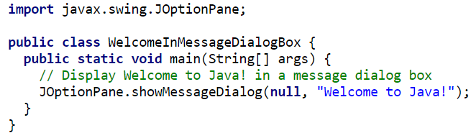
Displaying Text in a Message Dialog Box
you can use the showMessageDialog method in the JOptionPane class. JOptionPane is one of the many predefined classes in the Java system, which can be reused rather than “reinventing the wheel.”

Slide 31
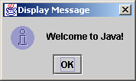
The showMessageDialog Method
JOptionPane.showMessageDialog(null,
"Welcome to Java!",
"Display Message",
JOptionPane.INFORMATION_MESSAGE);

Slide 32
Two Ways to Invoke the Method
There are several ways to use the showMessageDialog method. For the time being, all you need to know are two ways to invoke it.
One is to use a statement as shown in the example:
  JOptionPane.showMessageDialog(null, x,
  y, JOptionPane.INFORMATION_MESSAGE);
where x is a string for the text to be displayed, and y is a string for the title of the message dialog box.
The other is to use a statement like this:
  JOptionPane.showMessageDialog(null, x);
where x is a string for the text to be displayed.

